Slide 1
Analysis of Police Shootings
Years 2015-2020

Slide 2
WhiteLivesMatter v. BlackLivesMatter
One of the prevalent news recently among social media is the rise of police shootings and general discrimination leading to deaths focused towards black/African citizens of the USA The rise in “#BlackLivesMatter” trend led to a counter movement by the white supremacists as “#WhiteLivesMatter”. While the more illogically fearing white supremacists were open about the racism and felt like black people didn’t deserve the same rights or felt like that black people were getting more rights than deserved.

Slide 3
How to counter-argue?
The deaths of Breonna Taylor and George Floyd and many more over all these years have always tried to host the idea that there is open and conceited bias among the police when it comes to handling black people of the United States.
Hence, the point here is to prove, using the data of the shootings that we have, that there is bias against the black community whether open or conceited and try and explain what could be the reason for this bias.

Slide 4
What kinds of data?
The data we require are the census population of each state, the nation in total and their distributions per race and the shootings data spanning from year 2015 to 2020 respectively:
https://www.statista.com/statistics/183489/population-of-the-us-by-ethnicity-since-2000/
https://www.census.gov/data/tables/time-series/demo/popest/2010s-state-detail.html
https://www.kaggle.com/ahsen1330/us-police-shootings

Slide 5
Now that we have our data...
Our next steps must include -
Racial distribution of people shot (lethal vs nonlethal weapon carriers)
Racial distribution of people shot per million
Racial distribution of people shot per million, with a lethal weapon
State-wise distribution of % of white people shot
State-wise distribution of % of white people
State-wise distribution of % of black people shot
State-wise distribution of % of black people
Contrast data

Slide 6
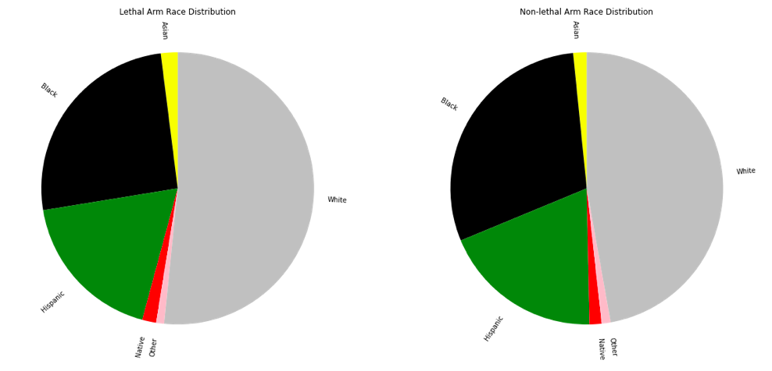
Racial Distribution of People Shot

Slide 7
White people die more?
Indeed, white people do die more than black people. But the other thing to be considered is that black communities are minorities, as in, they are much smaller in population compared to the white population. So when we normalise the shootings to see how many whites and blacks are shot per million, we get a better representation of the bias in question.

Slide 8
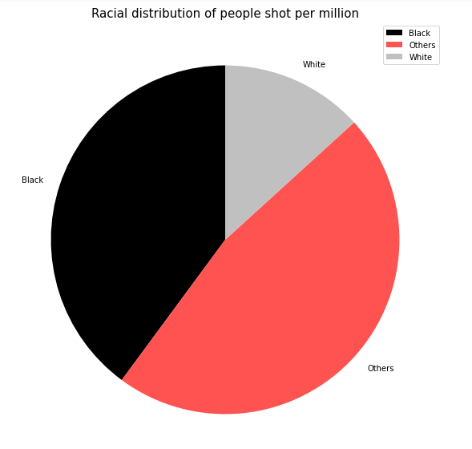
Oh no, where did the white go?

Slide 9
What actually happened
After dividing the number of victims shot per US population for each respective race, you can see that 16-20 people per 1 crore white Americans are shot every year by police, whereas 50-60 people per 1 crore black Americans are shot every year by police. If the black Americans were in equal numbers as the white Americans in the USA, people belonging to black or African race comprise 33% of the shootings per year.

Slide 10
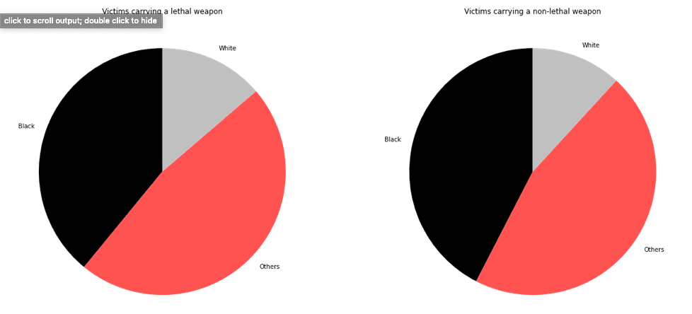
Where is this bias originating from?

Slide 11
Ah, so correlation?
Yes, the higher normalised population, that is, people per million of black race getting shot while carrying a lethal weapon serves as bias to correlate black people to be considered as dangerous. And hence, the higher non-lethal ratio of black people shot as well. What’s so wrong about this correlation is that it’s trying to pin the very basis racism relies on - black people are criminals. We can see where the bias comes from, just not the right correlation to look for.

Slide 12
So a bias exists, but where is it the highest?
To see bias clearly, first we need to map each of the shootings happening from 2015 to 2019, average the % of white people shot and black people shot as well as comparing them against the respective state populations.

Slide 13
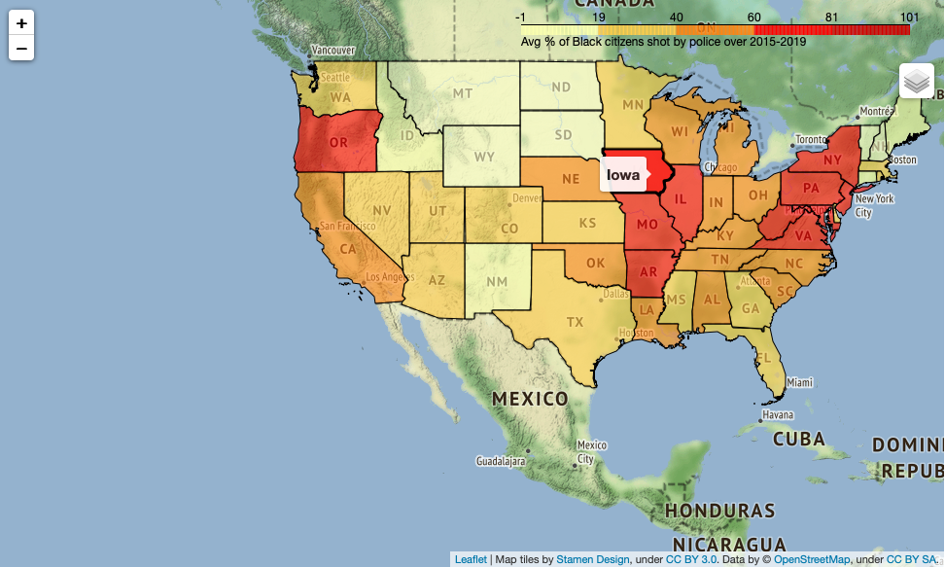
Avg. % of black people shot per state (2015-2019)

Slide 14
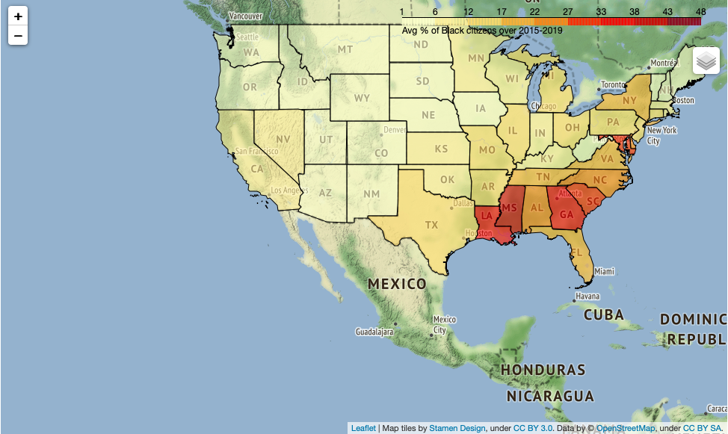
Avg % of black people per state (2015-2019)

Slide 15
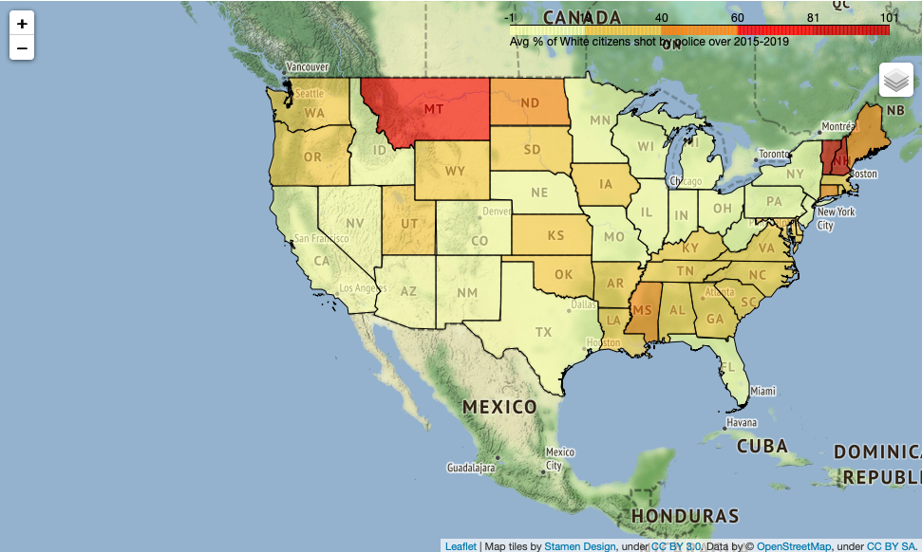
Avg % of white people shot per state (2015-2019)

Slide 16
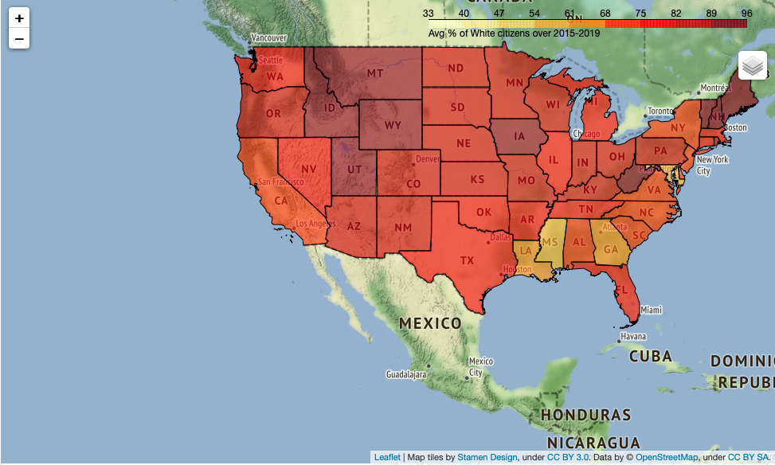
Avg. % of white people per state

Slide 17
Oh, the contrast!!
It’s understandable that a greater % of people shot are white in Montana and Vermont among other states because these places are dominantly white. But what about the other states? The % of people being white is very very low, as the yellowness of the state color indicates. On the other hand, black population is predominant in Louisiana and Mississippi among other states. However, the % of people shot being black is higher than whites in many white-dominant states. That’s the contrast we are looking for, which is called the bias. You can see the highest bias in states - OR, AR, IA, IL, NY, VA, PA, NJ and WV.

Slide 18
BlackLivesMatter
The recent deaths of Breonna Taylor and George Floyd have been echoing all through 2020 to show that the racism is prevalent, the riots in 2019, 2018 and 2016 all prove that racism is prevalent and yet the percentages of black population dying hasn’t reduced over the years and in fact, Oregon has seen one of the highest black victims in 2019. However, I can assure that there’s more data to dig into further, and I hope this can stand as a launchpoint for future associations.

Slide 19
References:
[1] https://www.splcenter.org/fighting-hate/extremist-files/group/white-lives-matter
[2] https://www.kaggle.com/ahsen1330/us-police-shootings
[3] https://www.statista.com/statistics/183489/population-of-the-us-by-ethnicity-since-2000/
[4] https://www.census.gov/data/tables/time-series/demo/popest/2010s-state-detail.html
[5] https://www.census.gov/geographies/mapping-files/time-series/geo/carto-boundary-file.html
[6] https://developers.google.com/public-data/docs/canonical/states_csv

Slide 20
Thank you for reading this.
Vaibhav V

